Slide 1
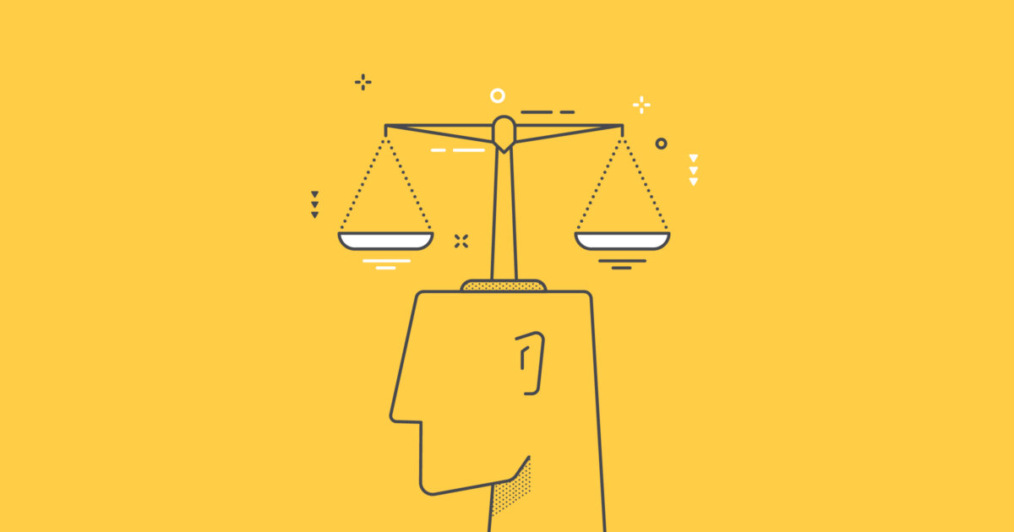
Integrating Utility, Rights, Justice and Caring
Pdf pg 135

Slide 2
So far, the chapter has outlined four main kinds of basic moral considerations:
1. Utilitarian standards - must be used when we do not have the resources to attain everyone's objectives, so we are forced to consider the net social benefits and social costs consequent on the actions (or policies or institutions) by which we can attain these objectives.
2. Standards that specify how individuals must be treated - must be employed when
our actions and policies will substantially affect the welfare and freedom of
specifiable individuals.

Slide 3
Moral reasoning of this type forces consideration of whether the behavior respects the basic rights of the individuals involved and whether the
behavior is consistent with one's agreements and special duties.
3. Standards of justice - indicate how benefits and burdens should be distributed among
the members of a group. These sorts of standards must be employed when evaluating
actions whose distributive effects differ in important ways.

Slide 4
Standards of caring
indicate the kind of care that is owed to those with whom we
have special concrete relationships. Standards of caring are essential when moral
questions arise that involve persons embedded in a web of relationships, particularly
persons with whom one has close relationships, especially those of dependency.

Slide 5
Utilitarian standards consider only the aggregate social welfare, but ignore the way that welfare is distributed as well as the moral claims of individuals.
Moral rights consider the individual but discount both aggregate well-being and distributive considerations.
Standards of justice consider distributive issues, but they ignore aggregate social welfare and the individual as such.
Although standards of caring consider the partiality that must be shown to those close to us, they ignore the demands of impartiality.

Slide 6
At this time, we have no comprehensive moral theory capable of determining precisely when utilitarian considerations become “sufficiently large” enough to outweigh limited infringements/violations on a conflicting right, a standard of justice, or the demands of caring.
Nor can we provide a universal rule that will tell us when considerations of justice become “important enough” to outweigh infringements on conflicting rights or on the demands of caring.
Moral philosophers have been unable to agree on any absolute rules for making such judgments.
Example page pdf 137

Slide 7
One simple strategy for ensuring that all four kinds of considerations are
incorporated into one's moral reasoning is to inquire systematically
into the utility, rights, justice, and caring involved in a given moral judgment.
One might, for example, ask a series of Questions about an action that one is considering:
(a) Does the action, as far as possible, maximize social
benefits and minimize social injuries?
(b) Is the action consistent with the moral rights of those
whom it will affect?
(c) Will the action lead to a just distribution of benefits and burdens?
(d) Does the action exhibit appropriate care for the well-being of
those who are closely related to or dependent on oneself?
Unfortunately, there is not yet any comprehensive moral theory to
show when one of these considerations should take precedence.

Slide 8
Unconscious Moral Decisions
Moral reasoning is the process of applying our moral principles to the knowledge or understanding we have about a situation, and making a judgment about what ought to be done in that situation.
You probably had several conversations during which you told the truth instead of lying, or you walked past other people’s property and did not steal it, or you kept your promise when you told someone that you would meet her after class or that you would return a pen she loaned you.
In these ethical decisions throughout your day, you did not go through the conscious and deliberate process of moral reasoning

Slide 9
It seems that we make many of our ethical decisions
without the kind of conscious moral reasoning about utility,
rights, justice, and caring.
A large number of psychological studies of the brain and its
processes have suggested that we have two ways of making
moral decisions: through conscious reasoning and through
unconscious mental processes.

Slide 10
We will look briefly now at what we know about these unconscious processes because the unconscious processes seem to be the processes by which we make the vast majority of our moral decisions.
Unconscious Moral Decision-Making
Scott Reynolds, a psychologist, calls X system for unconscious moral reasoning and C system for conscious moral reasoning.
The X system is based on the use of “schemas” or “prototypes.

Slide 11
Prototypes are general memories of the kinds of situations we have experienced in the past, together with the kinds of sounds, words, objects, or people those situations involved, the kind of emotions we felt, the way we behaved in those situations, the type of moral norms or rules that we followed, etc.
The brain uses these stored “prototypes” to analyze the new situations we encounter each day and to determine how to behave in those situations.
Our brain does this by trying to match each new situation we experience with its store of prototypes. If the new situation matches a stored prototype, then the brain recognizes that the new situation is the kind of situation represented by the prototype. The brain then uses the information stored in the prototype to identify what kind of behavior is appropriate for that kind of situation, what kind of moral norms apply in such a situation, what emotions are usual for such situations, etc.

Slide 12
Once a match is made, the conscious brain becomes aware of the match. We become conscious of recognizing the kind of situation we are in, and what behavior is appropriate in this kind of situation.
Prototypes are not fixed and unchanging. As we go through life and experience the same types of situation again and again, we add to their prototypes whatever new information we get from each experience.
Once we are conscious of the kind of situation we are in, however, we can begin to use our conscious reasoning processes—our C-system processes—to deal with it.

Slide 13
The C-system or conscious reasoning system uses processes that are more complicated than the simple matching of prototypes the X-system uses.
Conscious moral reasoning can deliberately gather information about a situation from our store of moral principles to see which ones might apply to this kind of situation, and it can then figure out what those moral principles require for the situation we face.
We also rely on conscious reasoning when we find ourselves in a new or unusual situation.

Slide 14
Cultural Influences and Intuition
Many of our moral beliefs are derived from the cultural influences that surrounded us as we grew up, i.e., from family, peer groups, stories, songs, magazines, television, radio, Mosque, church novels, newspapers, and so on.
These cultural influences no doubt are incorporated into our prototypes and thereby, shape our actions.
Of course, just because we acquire a moral belief from the culture around us, does not mean that it is necessarily correct, or incorrect.

Slide 15
Conscious moral reasoning and cultural influences are not the only sources of the prototypes that guide our ordinary actions. Some of our strongest held moral beliefs seem to be based on sheer intuition, i.e., we do not acquire them from our environment, nor are they based on any moral or non-moral reasons or reasoning.
Prototypes can be shaped by “hardwired” moral intuitions, as well as by conscious moral reasoning and cultural influences.

Slide 16
Hardwired intuitions seem to include: incest is wrong; harming by action is worse than harming by omission (For example, it is worse to kill a person than it is to allow a person to die without doing anything to prevent his death.) ;
harming as a means to a goal is worse than harming as a foreseen side effect; (For example, it is worse to jump out of a boat deliberately intending to kill myself by drowning than it is to jump out of a lifeboat so that there will be room for other survivors of a sinking ship even if I ultimately drown.)
harming by physical contact is worse than harming without physical contact. (For example, it is worse for a soldier to stab and kill an innocent villager, than it is for a pilot to drop a bomb that he knows will kill an unseen innocent villager.)

Slide 17
Hauser has shown that almost all people accept these principles when deciding whether it is morally worse to cause harm in one way rather than another.
But when pressed for the reasons why we accept these principles, most of us cannot provide any.
We seem to accept these principles not because we have reasoned them out but because they seem to be based on intuition.
The processes on which we base our moral decisions, then, can be rational even though they are unconscious.

Slide 18
Most important of all, it is possible for us to stand back and consciously think about the norms and rules that our brain seems to have incorporated into its prototypes and ask whether these norms and rules can be given any rational support.
By doing this, we can correct these previously accepted norms and rules accumulated from our culture—from parents, friends, movies, books, and other cultural influences—but also to the norms and rules that we know by intuition and that seem to be hardwired into the brain.
However, thinking about and weighing all the norms we have accumulated as we have grown older is a long and difficult process. It is the work of ethics, a work that can take a lifetime.

